Slide 1
$3,281,214 and 11 Other Reasons to Roll Over Your Qualified Money
Chicago Partners Wealth Advisors presents:

Slide 2
Who is Chicago Partners Wealth Advisors?
i
Nicole Polanco
Associate Advisor
Matt Grennell, J.D.
Senior Advisor
Jim Hagedorn, CFA
Founder

Slide 3
ii
Our Company Profile: By the Numbers
2007
$2 Billion
6
Chicago Partners is Founded
Assets Under Management
Financial Times Recognitions
Chicago Partners spun off from inside PricewaterhouseCoopers (PwC) after Sarbanes-Oxley regulations required auditor independence. Chicago Partners has been a member of the BSP Program since 2011.
Chicago Partners manages over $2 Billion in assets for over 650 clients, including high net worth individuals, corporations, foundations, and institutions.
Chicago Partners has been recognized as a Top 300 RIA by the Financial Times in 2014, 2015, 2016, 2017, 2018, & 2019.

Slide 4
01
A Comprehensive
Wealth Plan
1

Slide 5
A Comprehensive Wealth Plan
01
Developing a comprehensive wealth plan aligns all the separate
parts of your financial life toward your most important goal.
Investment
Portfolio
Financial
Planning
Customized
Reporting
System
Centralized
Document
Storage
“A goal without a plan is just a wish”
- Antoine de Saint-Exupery
Your
Wealth
Tax
Preparation
Estate
Planning
2

Slide 6
A Comprehensive Wealth Plan
01
Each person has his or her own unique financial goals and objectives.
Chicago Partners builds a wealth plan customized to reach those goals and objectives.
Your
Wealth
Goals
&
Objectives
Completely customized to your
goals and objectives
3

Slide 7
02
Your Balance Sheet:
Organized & Centralized
4

Slide 8
Your Balance Sheet Organized & Centralized
02
“The secret to all victory lies in the
organization of the non-obvious.”
- Marcus Aurelius
Roman Emperor, 161 - 180
5

Slide 9
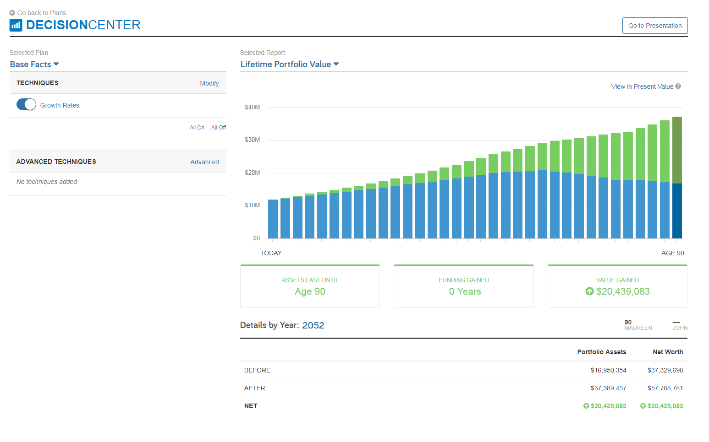
Your Balance Sheet Organized & Centralized
02
To organize the non-obvious of your balance sheet, Chicago Partners uses
Wealth Management System (WMS) to manage, create, and visualize cash flow plans.
The left is a typical modeling report our clients receive.
Using this report and others, clients and advisors are able to create better plans for retirement and other significant life events, like weddings, home purchases, or vacations.
6

Slide 10
03
An Optimized
Asset Location Strategy
7

Slide 11
An Optimized Asset Location Strategy
03
Being newly retired, you no longer have restriction requirements on your investment portfolio. Your portfolio is now opened to the entire universe of investment securities.
Number of possible investments in a restricted portfolio
Number of possible investments in an unrestricted portfolio
Strategies and tactics that may not have been available to you during your time at PwC are now viable. Chicago Partners can help you explore and leverage the strategies and tactics that are right for you.
8

Slide 12
An Optimized Asset Location Strategy
03
Your new portfolio will be designed for tax-efficiency from the beginning,
including the appropriate allocation between taxable and tax-deferred accounts.
This maximizes your after-tax income while reducing your tax liability.
01
02
Municipal Bonds
Master Limited Partnerships (MLP)
Municipal Bonds are exempt from taxation because they represent an obligation of the state or province.
MLP’s produce tax-deferred income, so placing MLP’s in a taxable account may amplify its benefits.
03
04
Equity Yield
Qualified Dividend Investments
Equities produce a lower amount of taxable ordinary income because many of the securities produce qualified dividends.
A qualified dividend investment already has tax-advantaged characteristics, so placing them in a taxable account allows an investor to reap the benefits of tax-advantaged income.
9

Slide 13
04
Your Foundation:
Your Optimized PRP
10

Slide 14
Your Foundation: Your Optimized PRP
04
When your PRP is excelling, it serves as a foundation for you to shift the
rest of your portfolio towards growth.
When your PRP is generating less income, it is a signal to shift some of
your growth-focused equity towards fixed income to compensate for the
lost income.
Strong PRP Performance: Model Allocation
Weak PRP Performance: Model Allocation
During periods of strong PRP performance, more capital is weighted towards equity to capitalize on the PRP’s stability.
When the PRP is not producing as much income, the portfolio shifts equity to fixed income to cover the lost income and stability provided by the PRP’s strong performance.
11

Slide 15
05
Health & Wellness:
HSA Optimization
12

Slide 16
Health & Wellness: HSA Optimization
05
Your HSA account is an independently-managed account used for qualified medical expenses. We work with our clients to ensure their HSA accounts are managed in concert with their other investment accounts.
Your Total Portfolio
Benefits of an HSA:
Contributions are not taxed on the way in
Investments grow tax-free
Capital used to pay for qualified medical expenses are not taxed on the way out
13

Slide 17
06
A Core Focus:
Your After-Tax Return
14

Slide 18
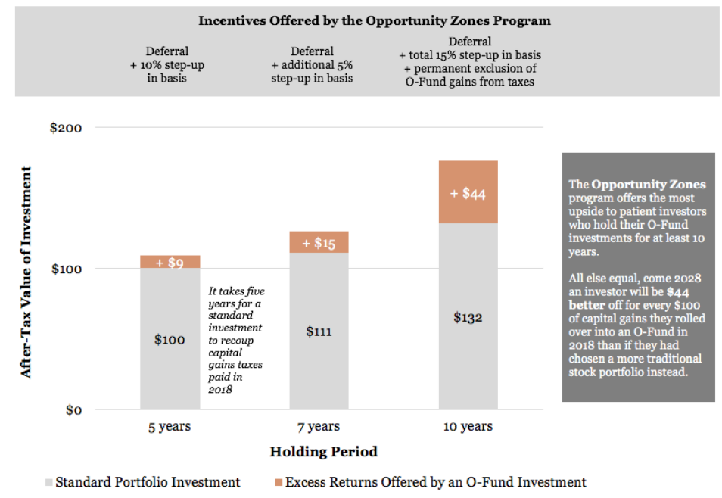
A Core Focus: Your After-Tax Return
06
After one year of retirement, comprehensive tax preparation by a CPA will be included for no additional cost. By working with your tax preparer, we can gain a more comprehensive view of your wealth plan, which serves as another aspect of your wealth that we can optimize.
Qualified Opportunity Zones (QOZ)
15

Slide 19
07
Secure Your Estate:
Optimize Your Estate Plan
16

Slide 20
Secure Your Estate: Optimize Your Estate Plan
07
Your estate plan is an integral part of your wealth plan. We review your current estate plan to align it with your financial goals and objectives.
It is recommended that estate plans are reviewed every 5 years – retirement is an excellent segue into your next review.
For our retired PwC Partner clients, Chicago Partners covers all estate planning and preparation costs that clients incur while building their custom estate plan.
17

Slide 21
08
Advisory Expenses:
Optimize How You Pay
18

Slide 22
Advisory Expenses: Optimize How You Pay
08
For clients with large IRA Rollover accounts, the option to pay advisory fees through this account represents a tax-free way to pay for investment services with tax-deferred dollars.
This payment strategy enhances the overall after-tax and after-fee return of the comprehensive portfolio.
Payment from Taxable Account
Payment from IRA
Paid with after-tax dollars
Paid with pre-tax dollars
19

Slide 23
09
Goals-Based Planning:
Insurance Plan & Review
20

Slide 24
Goals-Based Planning: Insurance Plan & Review
09
Clients work with their advisory team to conduct a review/audit of their current insurance plan and policies.
The review and subsequent planning is based on a combination of goals & objectives and PRP insurance plans.
Below are some sample questions we use when reviewing an insurance plan:
Are you self-insured?
What liabilities are covered by your insurance?
Do you have too much insurance?
21

Slide 25
10
Reducing Tax Liability:
Donor-Advised Funds
22

Slide 26
Reducing Tax Liability: Donor-Advised Funds
10
A Donor-Advised Fund (DAF) is a type of charitable account that allows donors to make qualifying contributions which reduce income tax liability in the year it was donated.
A donor can make grant recommendations to charities, or they can allow the funds to grow inside the account tax-free and outside of the donor’s estate.
Chicago Partners advises on DAF’s, but does not charge a fee on assets managed within the DAF.
Common Benefits of a DAF:
Can fund with appreciated securities
Tax-deductions for donations
Never pay capital gains that are donated
Tax-free growth that can be used for additional donations
23

Slide 27
11
Custom Reporting:
Private Banking & Family Office Reporting
24

Slide 28
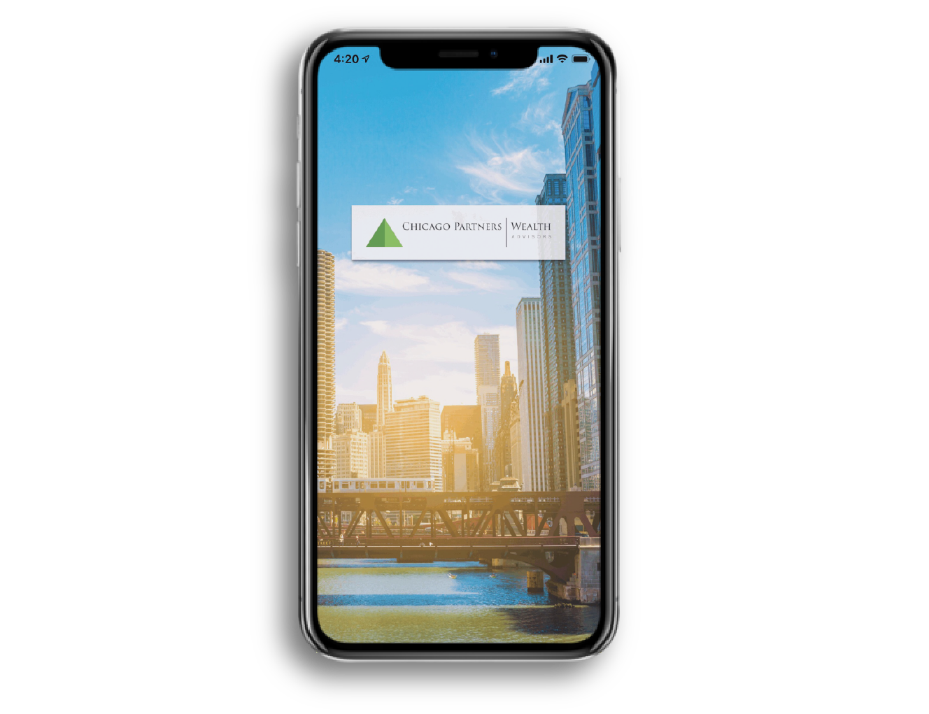
Custom Reporting: Private Banking & Family Office Reporting
11
All clients receive access to the Chicago Partners portal, which includes a complementary mobile application (available on the Apple Store and Google Play).
Clients receive current information about their portfolio’s performance, financial plan, and can contact their advisory team directly through the portal or app.
25

Slide 29
Custom Reporting: Private Banking & Family Office Reporting
11
Clients can also leverage their existing investment portfolio to obtain a line of credit at an industry-low interest rate.
By opening a Pledged Asset Line (PAL), a client can extend the depth and impact of their wealth.
A PAL’s interest rate is determined by the following equation:
$$Interest Rate= <1\%+30 day LIBOR$$
As of 8/14, the 30-day LIBOR is 2.21%.
26

Slide 30
12
RMD Optimization:
$3,281,214
27

Slide 31
RMD Optimization $3,281,214
12
Under current tax law, employees are not required to process Required Minimum Distributions (RMD’s) from their qualified accounts. We calculated the difference from not taking an RMD to be $3,281,214, which we see as a tremendous opportunity for retired PwC Partners.
The strategy is for you (as a retired PwC Partner) to work for Chicago Partners. You would roll over your qualified plan assets to the company’s profit-sharing plan.
From there, you can then avoid taking any RMD distributions because you are currently employed. You have complete authority over your account, and you can have it distributed at any time.
28

Slide 32
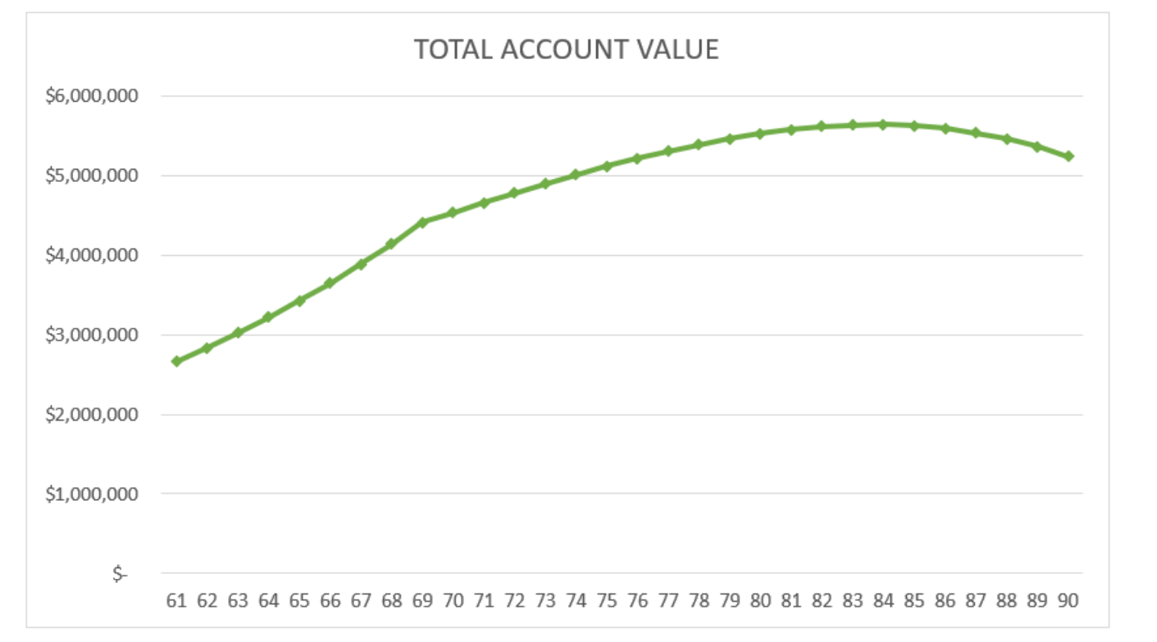
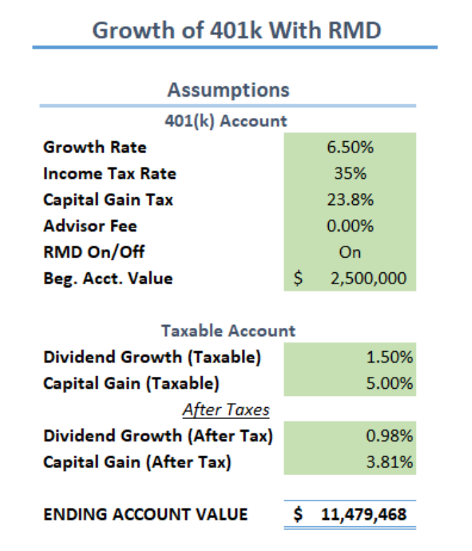
RMD Optimization $3,281,214
12
29

Slide 33
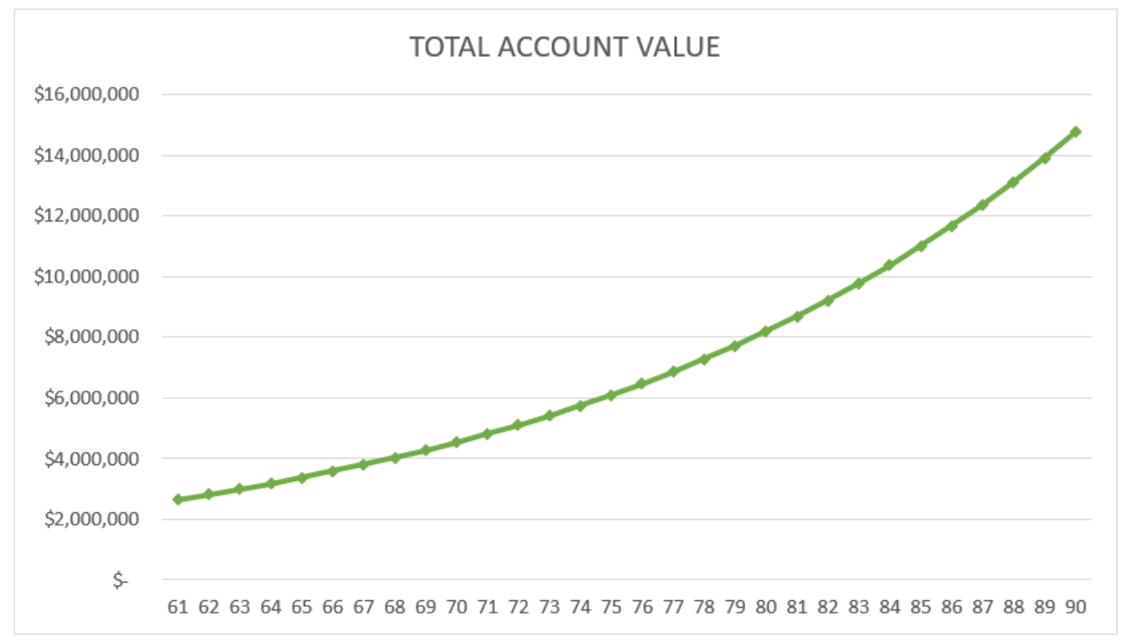
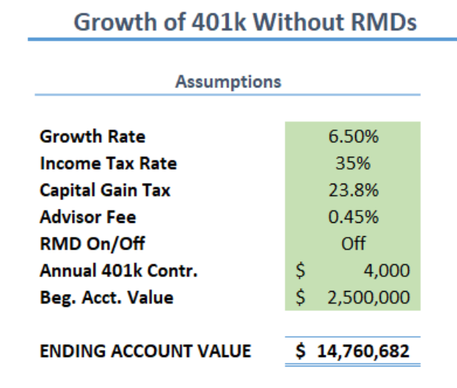
RMD Optimization $3,281,214
12
30

Slide 34
Thank you for attending!
Congratulations on a great career & successful retirement!
To set up a complementary Portfolio X-Ray, please contact:
Jim Hagedorn, CFA
Founder & Managing Partner
Phone: (312) 284-6363
jim@chicagopartnersllc.com
31

